Slide 1
ELECTRONIC MAIL
One of the most popular Internet services is electronic mail (e-mail). The designers of the Internet probably never imagined the popularity of this application program. Its architecture consists of several components that we discuss in this chapter.

Slide 2

Figure 26.6 First scenario in electronic mail

Slide 3

Note
When the sender and the receiver of an e-mail are on the same system,
we need only two user agents.

Slide 4

Figure 26.7 Second scenario in electronic mail

Slide 5
Note
When the sender and the receiver of an e-mail are on different systems, we
need two UAs and a pair of
MTAs (client and server).

Slide 6

Figure 26.8 Third scenario in electronic mail

Slide 7
Note
When the sender is connected to the mail server via a LAN or a WAN,
we need two UAs and two pairs
of MTAs (client and server).

Slide 8

Figure 26.9 Fourth scenario in electronic mail

Slide 9

Figure 26.10 Push versus pull in electronic email

Slide 10
Note
When both sender and receiver are connected to the mail server via
a LAN or a WAN, we need two
UAs, two pairs of MTAs
and a pair of MAAs.
This is the most common situation today.

Slide 11

Figure 26.11 Services of user agent

Slide 12

Figure 26.12 Format of an e-mail

Slide 13

Figure 26.13 E-mail address

Slide 14

Figure 26.17 Commands and responses

Slide 15
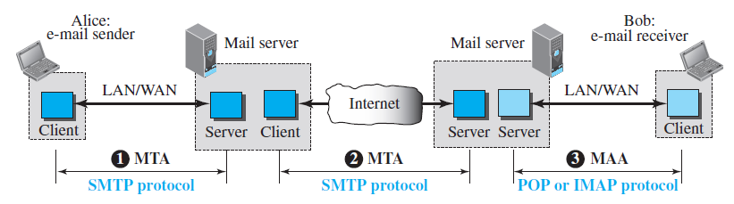
Protocols used in Email
Message Transfer Agent: SMTP

Slide 16
Which one of the following is not correct?
a) Application layer protocols are used by both source and destination devices during a communication session
b) HTTP is a session layer protocol
c) TCP is an application layer protocol
d) All of the mentioned

Slide 17
Consider different activities related to email.
m1: Send an email from a mail client to a mail server
m2: Download an email from mailbox server to a mail client
m3: Checking email in a web browser
Which is the application level protocol used in each activity?
(A) m1: HTTP m2: SMTP m3: POP
(B) m1: SMTP m2: FTP m3: HTTP
(C) m1: SMTP m2: POP m3: HTTP
(D) m1: POP m2: SMTP m3: IMAP

Slide 18
NAME SPACE
To be unambiguous, the names assigned to machines must be carefully selected from a name space with complete control over the binding between the names and IP addresses.

Slide 19
DOMAIN NAME SPACE
To have a hierarchical name space, a domain name space was designed. In this design the names are defined in an inverted-tree structure with the root at the top. The tree can have only 128 levels: level 0 (root) to level 127.

Slide 20

Figure 25.2 Domain name space

Slide 21

Figure 25.3 Domain names and labels

Slide 22
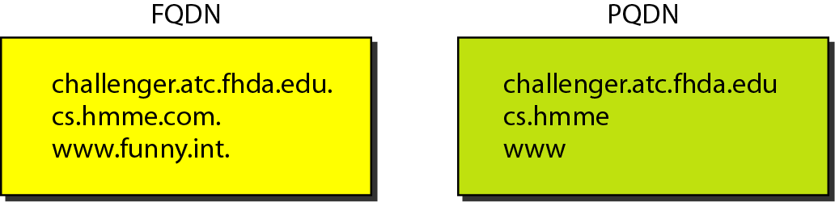
Figure 25.4 FQDN and PQDN

Slide 23
DISTRIBUTION OF NAME SPACE
The information contained in the domain name space must be stored. However, it is very inefficient and also unreliable to have just one computer store such a huge amount of information. In this section, we discuss the distribution of the domain name space.

Slide 24

Hierarchy of name servers

Slide 25
Note
A primary server loads all information from the disk file; the secondary server
loads all information from
the primary server.
When the secondary downloads
information from the primary, it is called zone transfer.

Slide 26
DNS IN THE INTERNET
DNS is a protocol that can be used in different platforms. In the Internet, the domain name space (tree) is divided into three different sections: generic domains, country domains, and the inverse domain.

Slide 27

DNS IN THE INTERNET

Slide 28

Generic domains

Slide 29

Table 25.1 Generic domain labels

Slide 30

Figure 25.10 Country domains

Slide 31

Figure 25.11 Inverse domain

Slide 32
FTP
File Transfer Protocol is a set of protocols that the networked computers use to talk over the internet. In more simple terms, it is a way to connect two computers and move files between them.

Slide 33
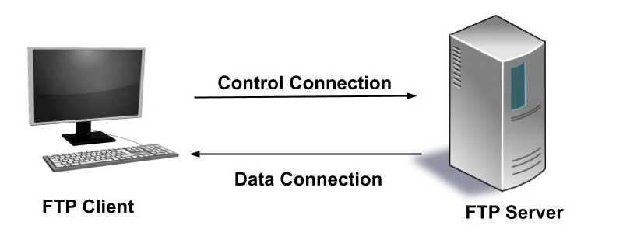

Slide 34
FTP server listens for connection on port number ____________
a) 20
b) 21
c) 22
d) 23

